Slide 1
Matryoshka Modeling Building one conceptual model within another
JCDL SIGCM Workshop
Conceptual Models in Digital Libraries, Archives, and Museums
Michael R. Gryk
June 6, 2019

Slide 2
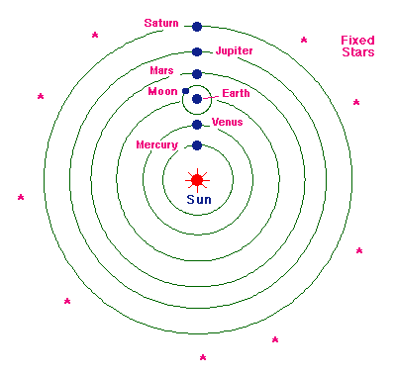
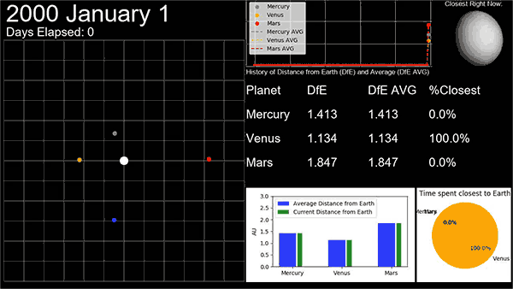
Which planet is closest to Earth?
Note that the question is not:
Which planet’s orbit is closets to the Earth’s orbit?
March 12th commentary in Physics Today
DOI:10.1063/PT.6.3.20190312a

Slide 3
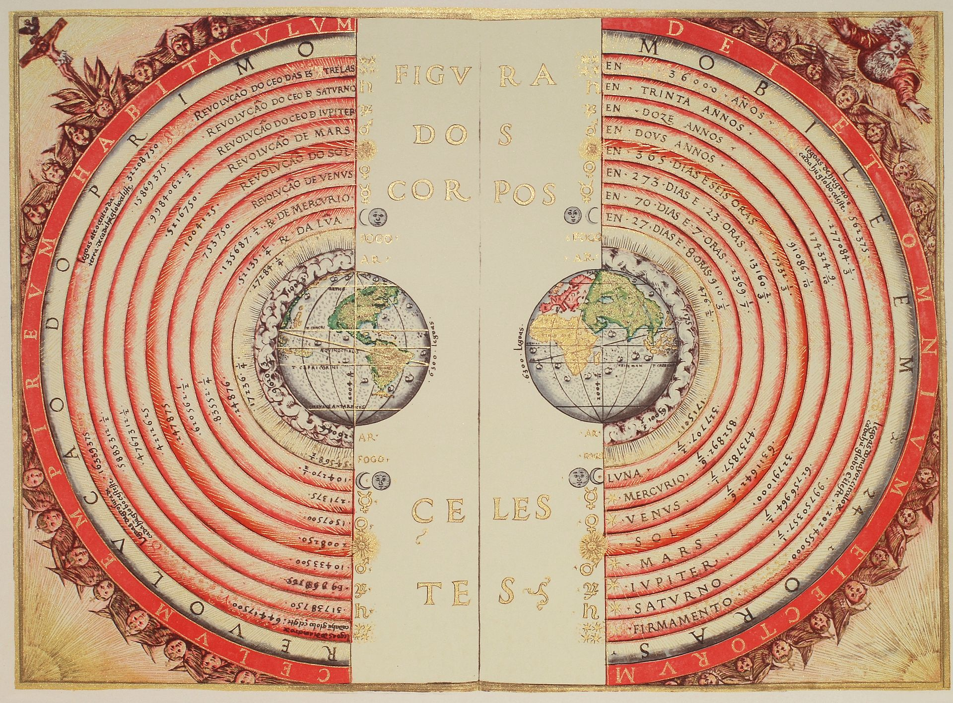
Which planet is closest to Earth?
This question is best answered from a geocentric point of view, not a heliocentric one.
In other words, unlearn Copernicus and return to Ptolemy.
Portuguese cosmographer and cartographer Bartolomeu Velho, 1568 (Bibliothèque Nationale, Paris)

Slide 4
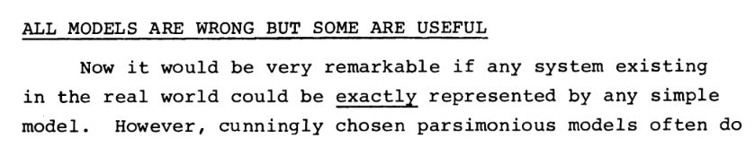
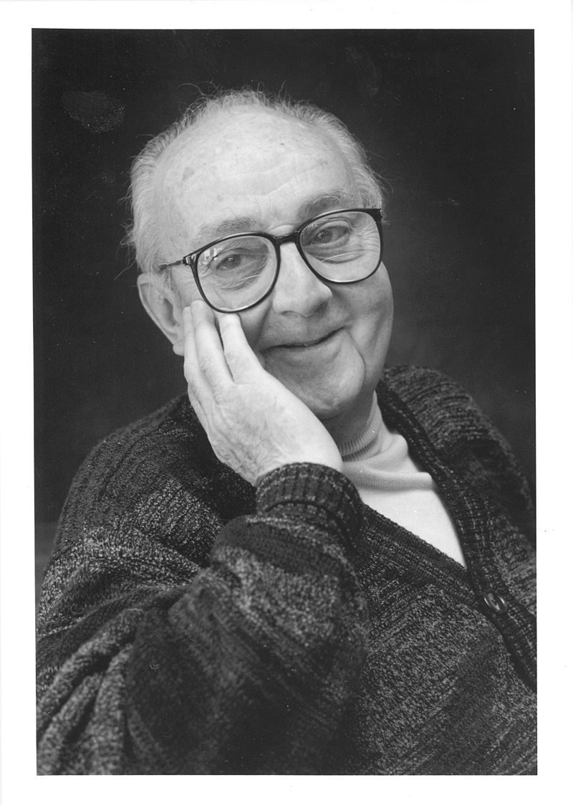
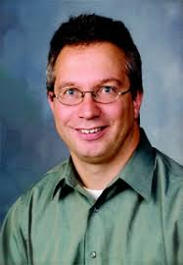
It’s all about the query!
Box, G. E. P. (1979), "Robustness in the strategy of scientific model
building", in Launer, R. L.; Wilkinson, G. N. (eds.),
Robustness in Statistics, Academic Press, pp. 201–236,
doi:10.1016/B978-0-12-438150-6.50018-2
Photo By DavidMCEddy at en.wikipedia, CC BY-SA 3.0, https://commons.wikimedia.org/w/index.php?curid=14941622
CORRECT ≠ USEFUL
USEFUL → PURPOSE

Slide 5
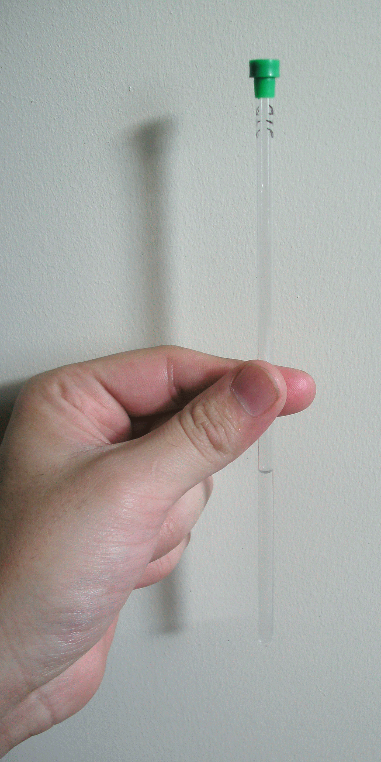
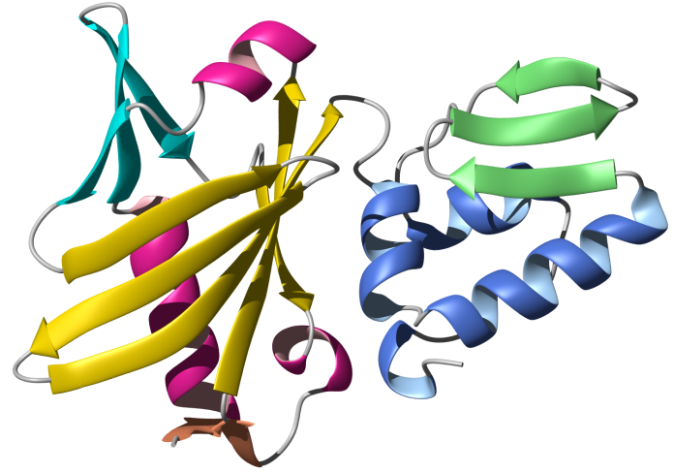
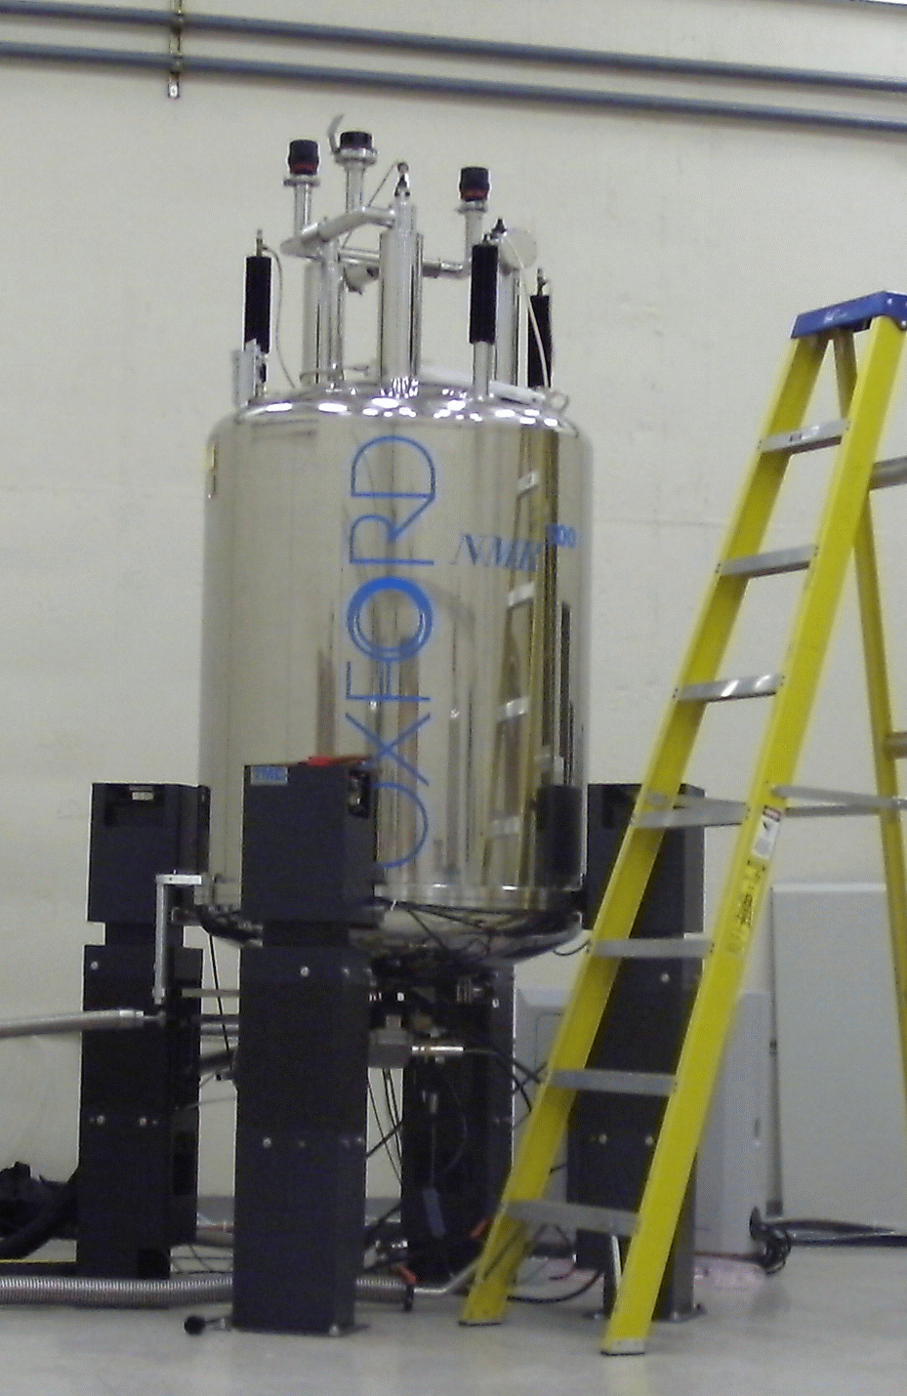
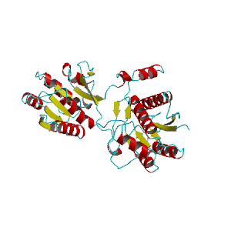
Biomolecular Nuclear Magnetic Resonance(BioNMR) Spectroscopy

Slide 6

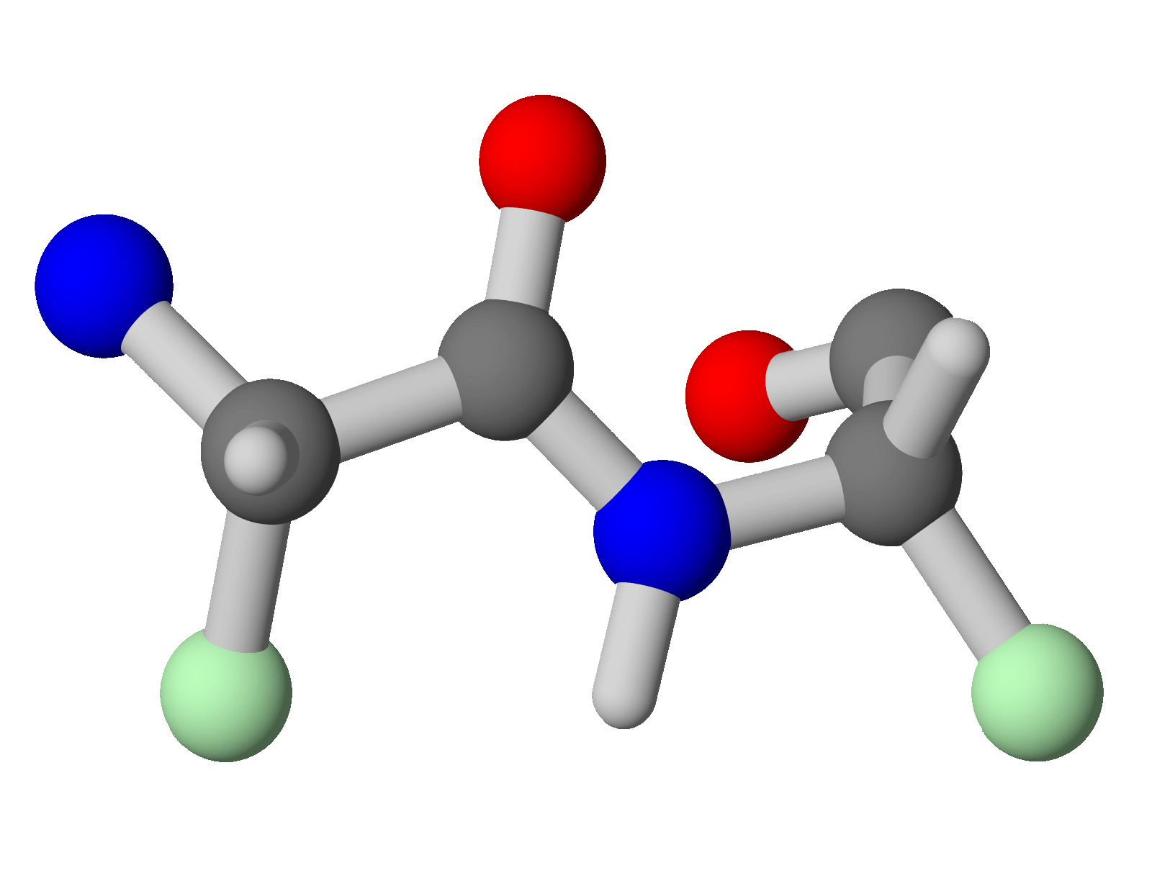

BioNMR Computation Pipeline
1
2
3
4
L10
+
A5
+
< 5Ǻ
Data
Collection
Transform to
Frequency
Identify
Signals
Biophysical
Claim
Reproducibility Points: Length analysis, many tools (some graphical)
Notes:
4 distinct stages. Describe. Important point is the time it takes – can take anywhere from months to years to complete a study. Without good record-keeping, much of the important reasoning in early stages can be lost by the time of data deposition. Also impacts handing over a research project midway – say if a student graduates midway.

Slide 7
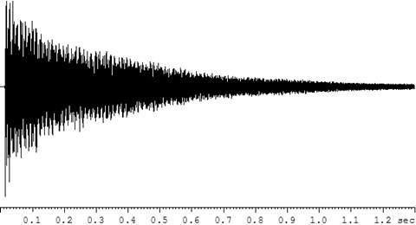

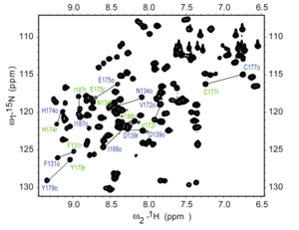
Scripting model for spectral reconstruction
#! /bin/csh
nmrPipe -in 22k_3l_nhsqct_000320.pipe \
| nmrPipe -fn SOL -mode 1 -fl 16 -fs 1 -poly \
| nmrPipe -fn CBF -last 12 \
| nmrPipe -fn GMB -lb -7 -gb 0.1 -size 512 -c 0.5 \
| nmrPipe -fn ZF -size 2048 \
| nmrPipe -fn FT -verb \
| nmrPipe -fn PS -p0 68.6 -p1 -34.8 -di \
| nmrPipe -fn EXT -left -sw -verb \
| nmrPipe -fn TP \
| nmrPipe -fn LP -fb -ord 30 -x1 2 -xn 128 -pred 64 -fix -fixMode 1 -after \
| nmrPipe -fn SP -off 0.39 -end 0.98 -pow 2 -size 192 -c 0.5 \
| nmrPipe -fn ZF -size 256 \
| nmrPipe -fn FT -verb \
| nmrPipe -fn PS -p0 -9.0 -p1 20.0 -di \
-out 22k_3l_nhsqct_000320.ft2 -ov
R
E
P
E
A
T
E
R
U
N
Linux shell scripts automate command line operations. Similar to .bat files in Windows.
Notes:
Possibly can Replicate. Need to have nmrpipe installed, csh available, and have paths correct. Long-term, nmrpipe has timebomb. Hash-bang calls shell for interpreting. ‘|’ means to take output from one command and use as input to another. ‘\’ ignores the carriage return. These dozen or so steps include data cleaning, signal enhancement and data transformation operations.

Slide 8
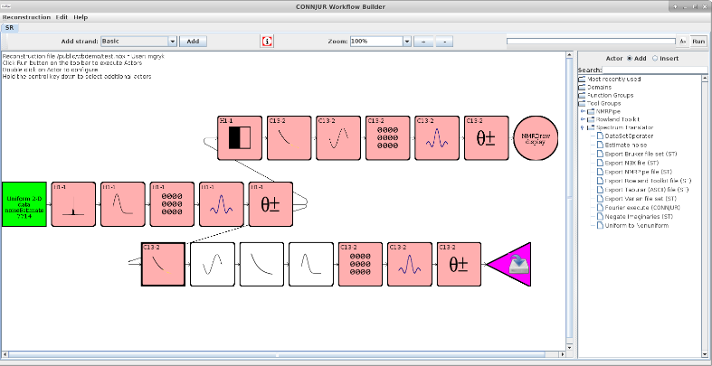
Workflow model for spectral reconstruction
R
R
E
E
R
R
E
P
L
I
C
A
T
E
U
E
U
N
A
S
T
E
Each of the “scripted” operations is abstracted as box. Green boxes are completed. Pink are configured but not yet executed. White are bypassed. Purple need configuration.
Notes:
Possibly can Replicate. Need to have nmrpipe installed, csh available, and have paths correct. Long-term, nmrpipe has timebomb. Hash-bang calls shell for interpreting. ‘|’ means to take output from one command and use as input to another. ‘\’ ignores the carriage return. These dozen or so steps include data cleaning, signal enhancement and data transformation operations.

Slide 9
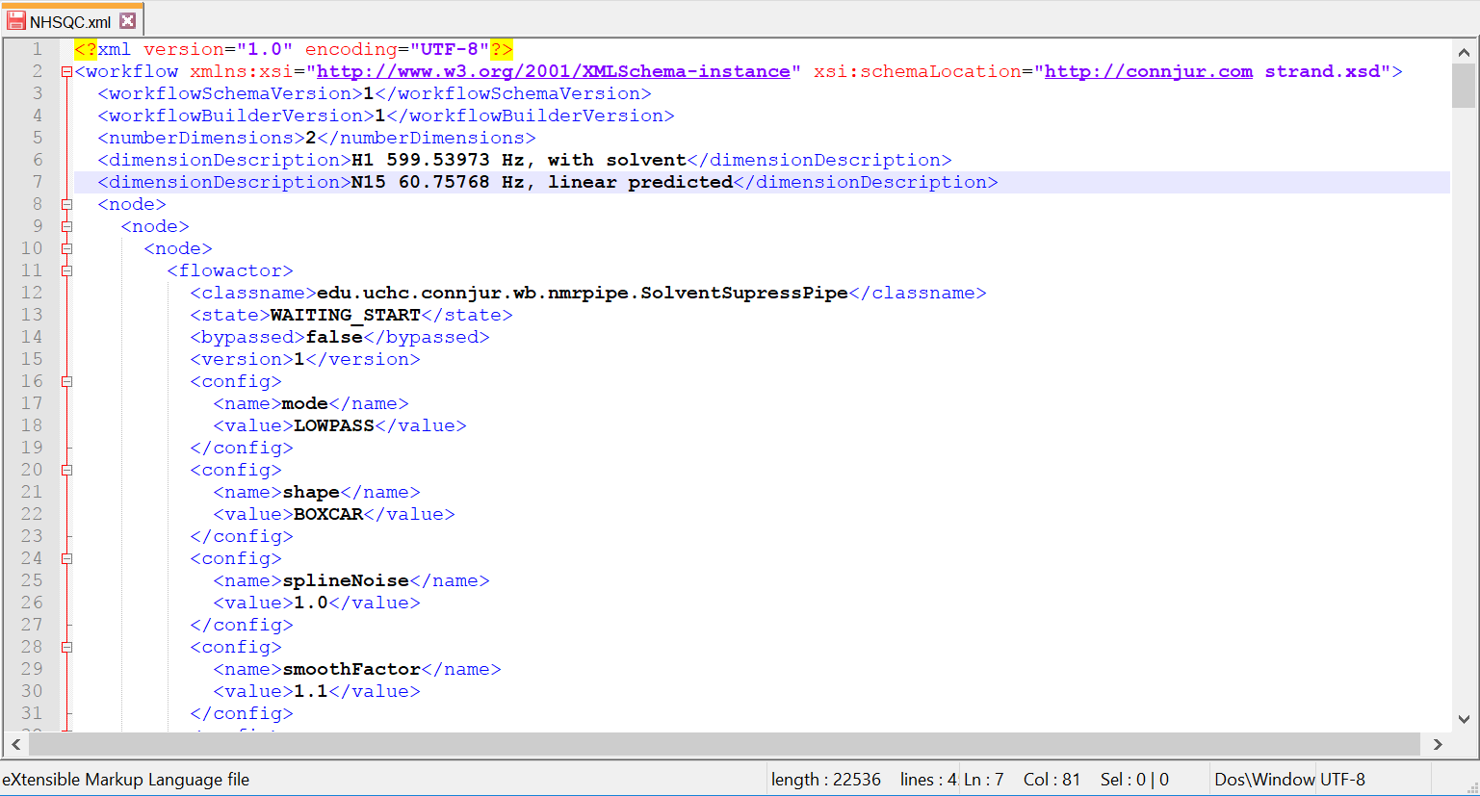
CONNJUR Workflow Builder XML (sharing)
U
R
E
S
DataSet
E
R
Actor
U
N
Notes:
Identifying the problem with custom XML is the next slide

Slide 10
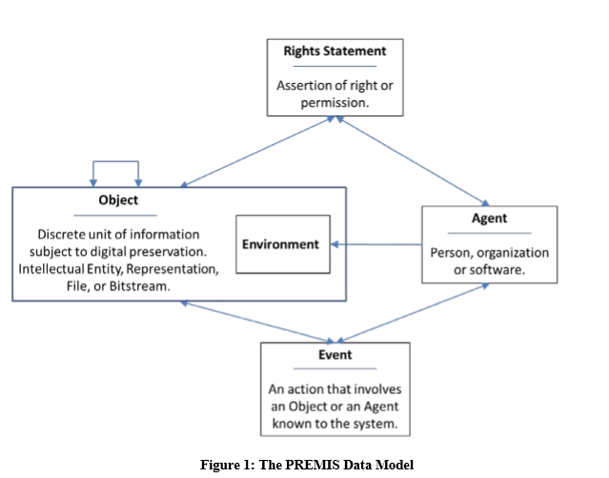
PREMIS: Preservation Metadata Implementation Strategies
Notes:
Audience knows PREMIS. Mention that the PREMIS model is similar to that of CWB – in fact it has all of the items we are interested in.

Slide 11
PREMIS Object Example
<?xml version="1.0" encoding="UTF-8"?>
<premis:premis version="3.0" … xmlns:premis="http://www.loc.gov/premis/v3">
<premis:object xsi:type="premis:file">
<premis:objectIdentifier>
<premis:objectIdentifierType>local</premis:objectIdentifierType>
<premis:objectIdentifierValue>001</premis:objectIdentifierValue>
</premis:objectIdentifier>
<premis:preservationLevel>
<premis:preservationLevelType>logical preservation</premis:preservationLevelType>
<premis:preservationLevelValue>emulation</premis:preservationLevelValue> >
</premis:preservationLevel>
<premis:significantProperties>
<premis:significantPropertiesType>character count</premis:significantPropertiesType>
<premis:significantPropertiesValue>4063</premis:significantPropertiesValue>
</premis:significantProperties>
<premis:significantProperties>
<premis:significantPropertiesType>word count</premis:significantPropertiesType>
<premis:significantPropertiesValue>712</premis:significantPropertiesValue>
</premis:significantProperties>
<premis:objectCharacteristics>
<premis:size>4859385</premis:size>
<premis:format>
<premis:formatDesignation>
<premis:formatName>WordPerfect for DOS</premis:formatName>
<premis:formatVersion>5.1</premis:formatVersion>
</premis:formatDesignation>
</premis:format>
</premis:objectCharacteristics>
</premis:object>
</premis:premis>
← Can extend significant properties
← Can extend object characteristics

Slide 12
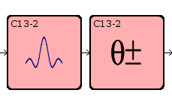
CONNJUR-ML Embedded within PREMIS
Dataset
Processing Task
Instrumentation
Axes
Units
Layout
Method
Parms
Field Strength
Hardware
Software
OBJECT
EVENT
AGENT

Slide 13
CONNJUR-ML embedded within PREMIS
PREMIS:OBJECTT
PREMIS:EVENT
PREMIS:AGENT
<premis:object xsi:type="premis:representation">
<premis:objectIdentifier>
<premis:objectIdentifierType>local</premis:objectIdentifierType>
<premis:objectIdentifierValue>13C,15N HSQC_000</premis:objectIdentifierValue>
</premis:objectIdentifier>
<premis:significantProperties>
<premis:significantPropertiesType>format</premis:significantPropertiesType>
<premis:significantPropertiesValue>varian</premis:significantPropertiesValue>
<premis:significantPropertiesExtension>
<connjur:spectrum xmlns:connjur="https://...connjur_ml.xsd">
<connjur:spectrumIdentifier>13C,15N HSQC_00</connjur:spectrumIdentifier>
<connjur:spectralDimensions>2</connjur:spectralDimensions>
<connjur:spectralAxis>
<connjur:decoupledNucleus>H1</connjur:decoupledNucleus>
<connjur:domain>time</connjur:domain>
<connjur:sweepwidth units="Hz">8511</connjur:sweepwidth>
<connjur:spectralFrequency units="MHz">600</connjur:spectralFrequency>
<connjur:pointType>complex</connjur:pointType>
<connjur:totalPoints>1024</connjur:totalPoints>
<connjur:negateImaginaries>true</connjur:negateImaginaries>
<connjur:constantPhase>051</connjur:constantPhase>
<connjur:linearPhase>000</connjur:linearPhase>
<connjur:sampling>uniform</connjur:sampling>
</connjur:spectralAxis>
<connjur:spectralAxis>
<connjur:decoupledNucleus>C13</connjur:decoupledNucleus>
<connjur:domain>time</connjur:domain>
<connjur:sweepwidth units="Hz">3000</connjur:sweepwidth>
<connjur:spectralFrequency units="MHz">151</connjur:spectralFrequency>
<connjur:pointType>complex</connjur:pointType>
<connjur:totalPoints>128</connjur:totalPoints>
<connjur:negateImaginaries>true</connjur:negateImaginaries>
<connjur:constantPhase>001</connjur:constantPhase>
<connjur:linearPhase>000</connjur:linearPhase>
<connjur:sampling>uniform</connjur:sampling>
</connjur:spectralAxis>
</connjur:spectrum>
</premis:significantPropertiesExtension>
</premis:significantProperties>
</premis:object>
<premis:event>
<premis:eventIdentifier>
<premis:eventIdentifierType>local</premis:eventIdentifierType>
<premis:eventIdentifierValue>Event_000</premis:eventIdentifierValue>
</premis:eventIdentifier>
<premis:eventType>acquisition</premis:eventType>
<premis:eventDateTime>Fri Jun 02 00:00:00 EDT 2000</premis:eventDateTime>
<premis:eventDetailInformation>
<premis:eventDetailExtension>
<connjur:metadata xmlns:connjur="https://.../connjur_ml.xsd">
<connjur:pulseSequenceName>gCNhsqc</connjur:pulseSequenceName>
</connjur:metadata>
</premis:eventDetailExtension>
</premis:eventDetailInformation>
<premis:linkingAgentIdentifier>
<premis:linkingAgentIdentifierType>local</premis:linkingAgentIdentifierType>
<premis:linkingAgentIdentifierValue>CONNJUR spectrum translator_000</premis:lAIV>
</premis:linkingAgentIdentifier>
<premis:linkingObjectIdentifier>
<premis:linkingObjectIdentifierType>local</premis:linkingObjectIdentifierType>
<premis:linkingObjectIdentifierValue>13C,15N HSQC_0</premis:linkingObjectIdentifierValue>
</premis:linkingObjectIdentifier>
</premis:event>
<premis:event>
<premis:eventIdentifier>
<premis:eventIdentifierType>local</premis:eventIdentifierType>
<premis:eventIdentifierValue>Event_004</premis:eventIdentifierValue>
</premis:eventIdentifier>
<premis:eventType>nmrPipe -fn FT</premis:eventType>
<premis:eventDateTime>Wed Sep 05 13:52:44 EDT 2018</premis:eventDateTime>
<premis:eventDetailInformation>
<premis:eventDetailExtension>
<connjur:configuration xmlns:connjur="https://.../connjur_ml.xsd">
<connjur:setAutomatically>true</connjur:setAutomatically>
<connjur:negateImaginaries>false</connjur:negateImaginaries>
<connjur:dimension>1</connjur:dimension>
</connjur:configuration>
</premis:eventDetailExtension>
</premis:eventDetailInformation>
</premis:event>
<premis:agent>
<premis:agentIdentifier>
<premis:agentIdentifierType>local</premis:agentIdentifierType>
<premis:agentIdentifierValue>SP_001</premis:agentIdentifierValue>
</premis:agentIdentifier>
<premis:agentName>UCONN Health Varian 600</premis:agentName>
<premis:agentType>hardware</premis:agentType>
<premis:agentExtension>
<connjur:spectrometer>
<connjur:strength units="T">14.1</connjur:strength>
<connjur:channel>
<connjur:nucleus>1H</connjur:nucleus>
<connjur:frequency units="Mhz">599.98</connjur:frequency>
</connjur:channel>
<connjur:channel>
<connjur:nucleus>13C</connjur:nucleus>
<connjur:frequency units="Mhz">150.54</connjur:frequency>
</connjur:channel>
<connjur:channel>
<connjur:nucleus>15N</connjur:nucleus>
<connjur:frequency units="Mhz">60.78</connjur:frequency>
</connjur:channel>
</connjur:spectrometer>
</premis:agentExtension>
</premis:agent>
<premis:agent>
<premis:agentIdentifier>
<premis:agentIdentifierType>local</premis:agentIdentifierType>
<premis:agentIdentifierValue>CONNJUR spectrum translator</premis:agentIdentifierValue>
</premis:agentIdentifier>
<premis:agentName>CONNJUR spectrum translator</premis:agentName>
<premis:agentType>software</premis:agentType>
<premis:linkingEventIdentifier>
<premis:linkingEventIdentifierType>local</premis:linkingEventIdentifierType>
<premis:linkingEventIdentifierValue>Event_000</premis:linkingEventIdentifierValue>
</premis:linkingEventIdentifier>
</premis:agent>

Slide 14
Modeling Conflicts (3 Events inside 1)
In slide 6, Data Collection is shown as a single event. It is also listed as such in our first-pass PREMIS documentation of provenance.
Inspection of metadata from a scientific dataset shows 3 pieces of metadata which all appear to be related to spectral range.
pw 6 1 13 13 13 2 1 8194 1 64
1 9.1
0
fb 7 1 6 6 6 2 1 8203 0 64
1 5000
0
sw 1 1 5 5 5 2 1 8203 1 64
1 8510.63829787
0

Slide 15
Modeling Conflicts (Options)
Event ontology allows recursive linking of events to subevents.
Not PREMIS
We can model three separate events and link each to object.
We can retain single event but use attributes to distinguish subevents
pw 6 1 13 13 13 2 1 8194 1 64
1 9.1
0
fb 7 1 6 6 6 2 1 8203 0 64
1 5000
0
sw 1 1 5 5 5 2 1 8203 1 64
1 8510.63829787
0

Slide 16

Modeling Conflicts (Ambiguous metadata)
We need to support datasets at many stages of processing. Software tools flatten metadata.
FILE: pipe.dat DIM: 2 QUAD: Complex 2DMODE: States Not Transposed
BYTES: 1050624 PRED: 1050624 MIN: 0 MAX: 0 VALID: 0
ORDER: 2 1 PIPE: 0 CUBE: 0 FILES: 1 1024x128x2 Swapped
X-Axis Y-Axis
DATA SIZE: 1024 128
APOD SIZE: 1024 0
SW Hz: 8510.638672 2200.000000
OBS MHz: 599.553223 60.752201
ORIG Hz: -1385.940430 6055.571289
DOMAIN: Freq Time
MODE: Real Complex
NAME: 1H 15N

Slide 17
Modeling Conflicts (Options)
We can infer Events and Agents from metadata, but this will often be erroneous.
We can model the same metadata in Objects, Events and Agents and populate what we know.
FILE: pipe.dat DIM: 2 QUAD: Complex 2DMODE: States Not Transposed
BYTES: 1050624 PRED: 1050624 MIN: 0 MAX: 0 VALID: 0
ORDER: 2 1 PIPE: 0 CUBE: 0 FILES: 1 1024x128x2 Swapped
X-Axis Y-Axis
DATA SIZE: 1024 128
APOD SIZE: 1024 0
SW Hz: 8510.638672 2200.000000
OBS MHz: 599.553223 60.752201
ORIG Hz: -1385.940430 6055.571289
DOMAIN: Freq Time
MODE: Real Complex
NAME: 1H 15N

Slide 18


Acknowledgements
Committee: Drs. Ludäscher, Dubin, Schneider & Twidale
CONNJUR: Drs. Ellis, Fenwick, Martyn, Nowling & Vyas (and other team members)
NMRbox: Drs. Delaglio, Hoch, Maciejewski, & Schulyer. Gerard Weatherby (and other team members).
BMRB: Drs. Romero & Ulrich (and other team members)
iSchool courses: Dr. Bettivia & Douglas Heintz

Slide 20
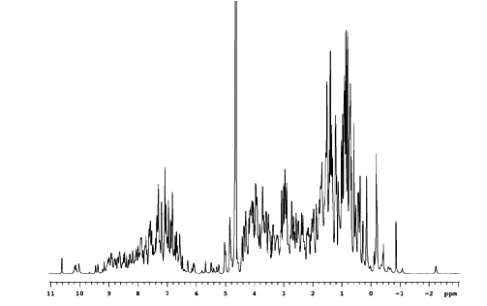
Basic Principles: The NMR Spectrum
Lysozyme ¹H Spectrum
at 900 MHz
Spectral Range on order of 10 KHz
Absorbance
Resonance Frequency (MHz)
900.009 MHz
900.000 MHz
Dispersion in NMR spectra is small, on order of parts per million. We
conventionally subtract a known reference frequency, divide through by the
static field strength, and reference the spectrum in units of (ppm).

Slide 21
Basic Principles: Fourier Excitation
Fourier’s theorem dictates that if we apply a square radio
frequency pulse of finite duration, it is equivalent to
applying a large series of pure frequencies.
FT
time
frequency
In essence, we can excite all NMR frequencies simultaneously.
Caveat: The frequency spread is inversely proportional to the
duration of the pulse. To cover a large range of frequencies we
need a short pulse.

Slide 22
Preliminary Results (3 Events from 1)
Inspection of metadata from a scientific dataset shows 3 pieces of metadata which all appear to be related to spectral range.
pw 6 1 13 13 13 2 1 8194 1 64
1 9.1 ~ 100,000 Hz spectral range
0
fb 7 1 6 6 6 2 1 8203 0 64
1 5000
0
sw 1 1 5 5 5 2 1 8203 1 64
1 8510.63829787
0

Slide 23
Filter bandwidth (fb) sets the bandwidth of the audio filters, which prevents noise of higher frequency than the spectral limits from “folding in” to the spectrum. Because the transmitter is in the center of the spectrum, the range of audio frequencies that must be filtered out is half the spectral width sw (e.g., for a spectral width of 4000 Hz, frequencies higher than ±2000 Hz should be filtered out). The audio filters have some attenuation at frequencies lower than their nominal cutoff frequency, which is the frequency at which signals have been attenuated by 3 dB (50%). This impacts on quantitative accuracy near the edges of the spectrum so that the standard value of fb is 10% more than half of sw.
fb is automatically changed whenever the spectral width sw is changed and thus is normally not a user-entered parameter. For example, typing sw=4000 automatically sets fb=2200, which is 10% more than 2000 Hz. After changing the value of sw, fb can be changed.
Values: if sw is 500,000 or less: 1000 to 256000 Hz, 1000-Hz steps. if sw is greater than 500,000: 256 kHz, 1 MHz.”

Slide 24
Preliminary Results (3 Events from 1)
Inspection of metadata from a scientific dataset shows 3 pieces of metadata which all appear to be related to spectral range.
pw 6 1 13 13 13 2 1 8194 1 64
1 9.1 ~ 100,000 Hz spectral range
0
fb 7 1 6 6 6 2 1 8203 0 64
1 5000 = 9,000 Hz spectral range
0
sw 1 1 5 5 5 2 1 8203 1 64
1 8510.63829787
0

Slide 25
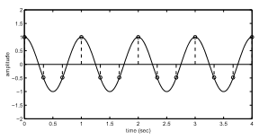
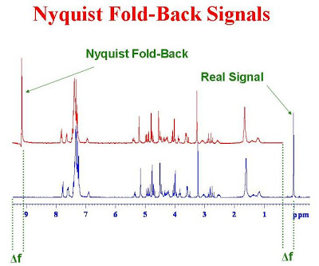
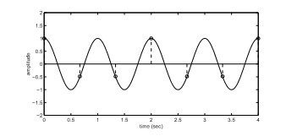
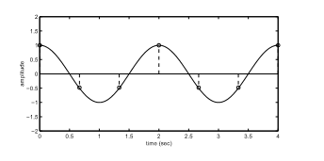
Nyquist Aliasing (sw)
http://u-of-o-nmr-facility.blogspot.com/2008/05/nyquist-fold-back-signals.html
http://www.rctn.org/bruno/npb261/aliasing.pdf

Slide 26
Spectral Width (sw) sets the total width of the spectrum to be acquired, from one end to the other. All spectra are acquired using quadrature detection. The spectral width determines the sampling rate for data, which occurs at a rate of 2*sw points per second (actually sw pairs of complex points per second).
Note that the sampling rate itself is not entered, either directly or as its inverse (known on some systems as the dwell time). If a value of sw is entered whose inverse is not an even multiple of the time base listed above, sw is automatically adjusted to a slightly different value to give an acceptable sampling rate.
All pulse programmers use four different timers, and the time count (the number of time units to be counted down by the timer) is a 12-bit binary number, resulting in values between 1 and 4096….

Slide 27
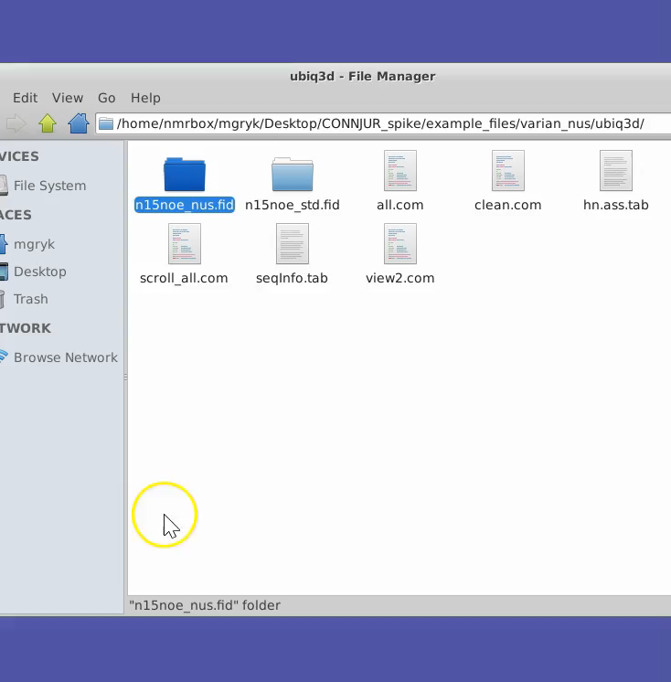
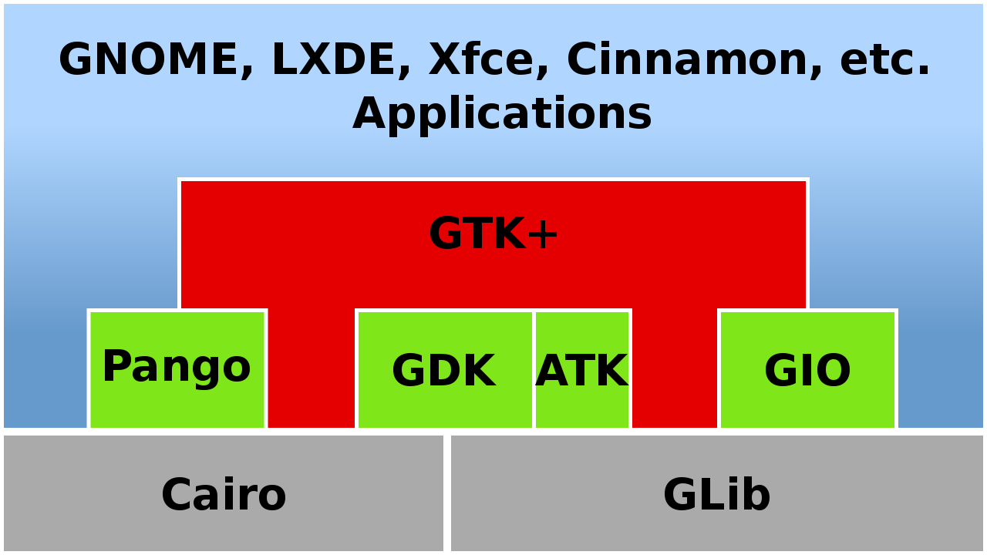
GTK+ Widgets for Metadata Management
We need data creators to be data curators. Energy barrier of instructing creators what annotations are important, and also conveying underlying data/metadata/provenance models to them to ease the burden of data entry.
HCI problem. Rapid prototyping of metadata widgets using GTK+ libraries – native interface in Xubuntu.

Slide 28
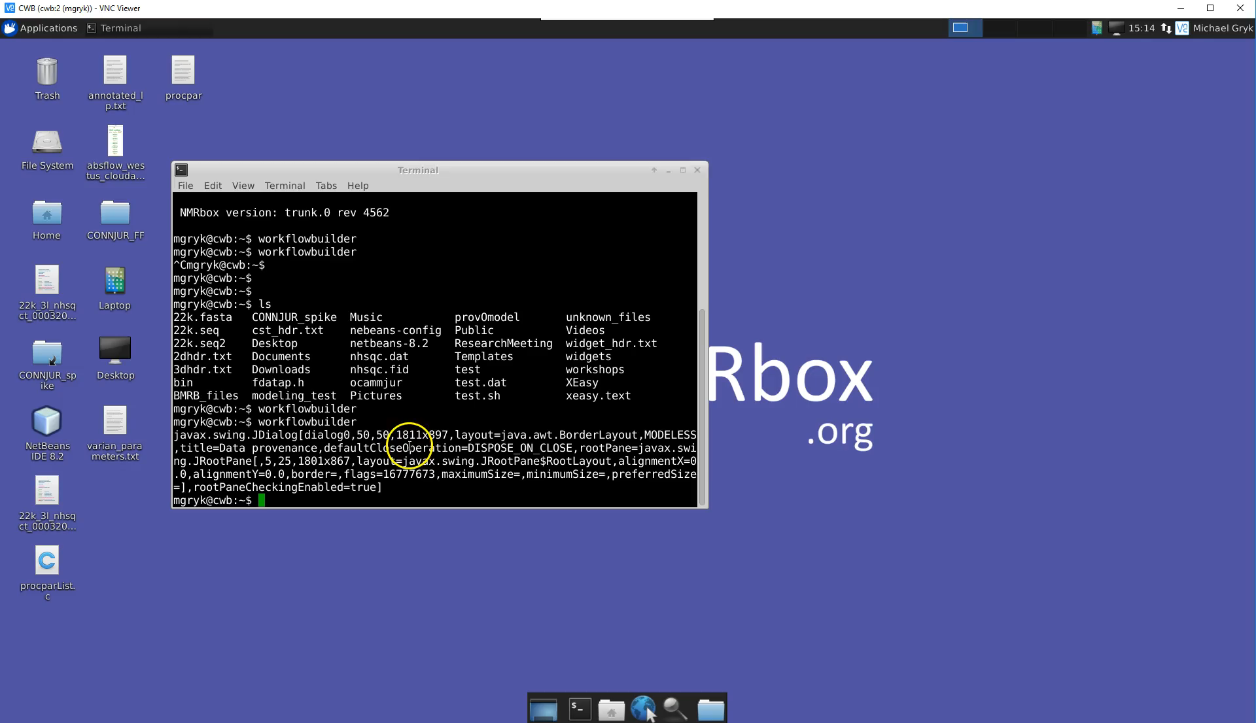
NMRbox: Cloud-based Virtual Machines
Persistent archived software; complete computing environment
Notes:
We resurrect our R’s in the context of the cloud environment.

